Slide 1
Computer Instruction or Instruction Set

Slide 2
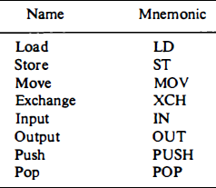
The set of instructions are defined for a particular processor is called as an instruction set.
Most computer instructions can be classified into three categories:
Data transfer instructions
Data manipulation instructions
Program control instructions
1.Data transfer instructions
Data transfer instructions move data from one place in the computer to another without changing the data content.

Slide 3
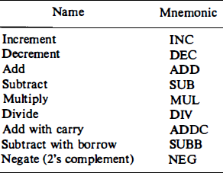
2.Data Manipulation Instructions
Data manipulation instructions perform operations on data and provide the computational capabilities for the computer. The data manipulation instructions in a typical computer are usually divided into three basic types:
Arithmetic instructions
Logical and bit manipulation instructions
Shift instructions
Arithmetic instructions:

Slide 4
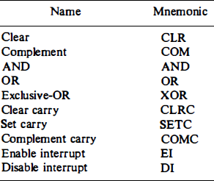
Logical and Bit Manipulation Instructions:Logical instructions perform binary operations on strings of bits stored in registers.

Slide 5
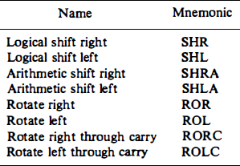
Shift Instructions:

Slide 6
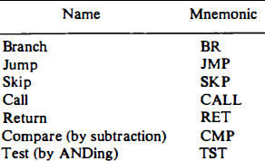
3.Program Control instructions:

Slide 7
Outlining instruction sets of some common CPUs
There are Different Types of Instruction sets:
1.Reduced instruction set computer(RISC)
2.Minimal instruction set computers(MISC)
3.Complex instruction set computer(CISC)
4.Explicitly parallel instruction computing(EPIC)
5.Very long instruction word (VLIW)
6.Zero instruction set computer(ZISC)
7.One instruction set computer(OISC)

Slide 8
Reduced Instruction set Computer(RISC)
RISC Architecture ,the instruction set of the Computer system is simplified to reduce the execution time.
RISC architecture has a small set of instructions that generally includes register-to-register operations.
RISC processors can execute only one instruction per clock cycle.
Characteristics:
1. It has simpler instructions and thus simple instruction decoding.
2. More general-purpose registers.
3. The instruction takes one clock cycle in order to get executed.
4. The instruction comes under the size of a single word.
5. Pipeline can be easily achieved.
6. Few data types.
7. Simpler addressing modes.

Slide 9
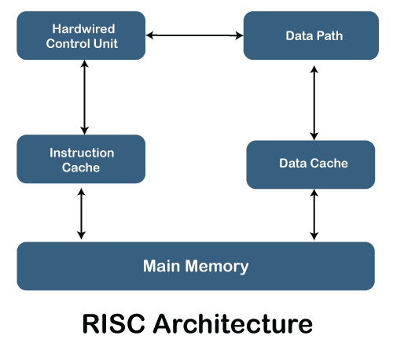
RISC Architecture

Slide 10
The hardware of RISC architecture is designed to execute the instruction quickly, which is possible because of the more precise and smaller number of instructions and a large number of registers.
In RISC,the data path is used to store and manipulate data in computer. It is responsible for managing data with in the processor and its movement between the processor and the memory.
The processor uses a cache to reduce the access time to the main memory. The instruction cache is beneficial for retrieving and storing the data of frequently used instructions. It speeds up the process of instruction execution.
The data cache provides storage for frequently used data from memory.

Slide 11
Advantages
Simplified instruction set
Format length is fixed
Register based architecture
Fewer cycles
Load-store architecture
Disadvantages
Complex instructions and addressing modes
Direct memory-to memory transfer
Increase in the program length

Slide 12
Complex Instruction Set Computer
The CISC architecture comprises a complex instruction set. A CISC processor has a variable-length instruction format. In this processor architecture, the instructions that require register operands can take only two bytes.
CISC processor, the execution of instructions may take a varying number of clock cycles. The CISC processor also provides direct manipulation of operands that are stored in the memory.
Characteristics:
The length of the code is shorts, so it requires very little RAM.
CISC or complex instructions may take longer than a single clock cycle to execute the code.
Less instruction is needed to write an application.
It provides easier programming in assembly language.
Support for complex data structure and easy compilation of high-level languages.
It is composed of fewer registers and more addressing nodes, typically 5 to 20.
Instructions can be larger than a single word.
It emphasizes the building of instruction on hardware because it is faster to create than the software.

Slide 13
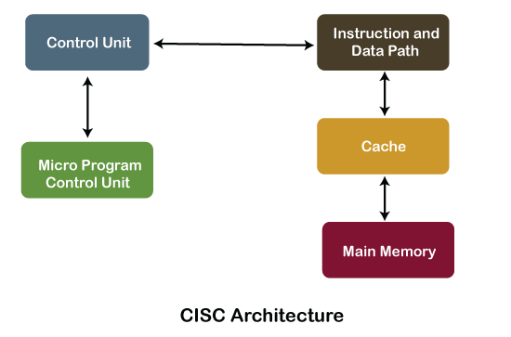
CISC Architecture

Slide 14
The CISC architecture helps reduce program code by embedding multiple operations on each program instruction, which makes the CISC processor more complex.
The CISC architecture-based computer is designed to decrease memory costs because large programs or instruction required large memory space to store the data, thus increasing the memory requirement, and a large collection of memory increases the memory cost, which makes them more expensive.
The primary objective of the CISC processor architecture is to support a single machine instruction for each statement that is written in a high-level programming language.
Many CISC architectures read the inputs and write their outputs in the memory system instead of a register file.
As CISC architecture takes a large number of addressing modes, more hardware logic is required to implement them. This reduces the computation speed.

Slide 15
Advantages of CISC Processors
The compiler requires little effort to translate high-level programs or statement languages into assembly or machine language in CISC processors.
The code length is quite short, which minimizes the memory requirement.
To store the instruction on each CISC, it requires very less RAM.
Execution of a single instruction requires several low-level tasks.
CISC creates a process to manage power usage that adjusts clock speed and voltage.
It uses fewer instructions set to perform the same instruction as the RISC.
Disadvantages of CISC Processors
CISC chips are slower than RSIC chips to execute per instruction cycle on each program.
The performance of the machine decreases due to the slowness of the clock speed.
Executing the pipeline in the CISC processor makes it complicated to use.
The CISC chips require more transistors as compared to RISC design.
In CISC it uses only 20% of existing instructions in a programming event.

Slide 16
Differences between RISC and CISC
RISC | CISC
It is a Reduced Instruction Set Computer. | It is a Complex Instruction Set Computer.
It emphasizes on software to optimize the instruction set. | It emphasizes on hardware to optimize the instruction set.
It is a hard wired unit of programming in the RISC Processor. | Microprogramming unit in CISC Processor.
It requires multiple register sets to store the instruction. | It requires a single register set to store the instruction.
RISC has simple decoding of instruction. | CISC has complex decoding of instruction.
Uses of the pipeline are simple in RISC. | Uses of the pipeline are difficult in CISC.
It uses a limited number of instruction that requires less time to execute the instructions. | It uses a large number of instruction that requires more time to execute the instructions.
It uses LOAD and STORE that are independent instructions in the register-to-register a program's interaction. | It uses LOAD and STORE instruction in the memory-to-memory interaction of a program.
RISC has more transistors on memory registers. | CISC has transistors to store complex instructions.
The execution time of RISC is very short. | The execution time of CISC is longer.
RISC architecture can be used with high-end applications like telecommunication, image processing, video processing, etc. | CISC architecture can be used with low-end applications like home automation, security system, etc.
It has fixed format instruction. | It has variable format instruction.
The program written for RISC architecture needs to take more space in memory. | Program written for CISC architecture tends to take less space in memory.
Example of RISC: ARM, PA-RISC, Power Architecture, Alpha, AVR, ARC and the SPARC. | Examples of CISC: VAX, Motorola 68000 family, System/360, AMD and the Intel x86 CPUs.

